Slide 1





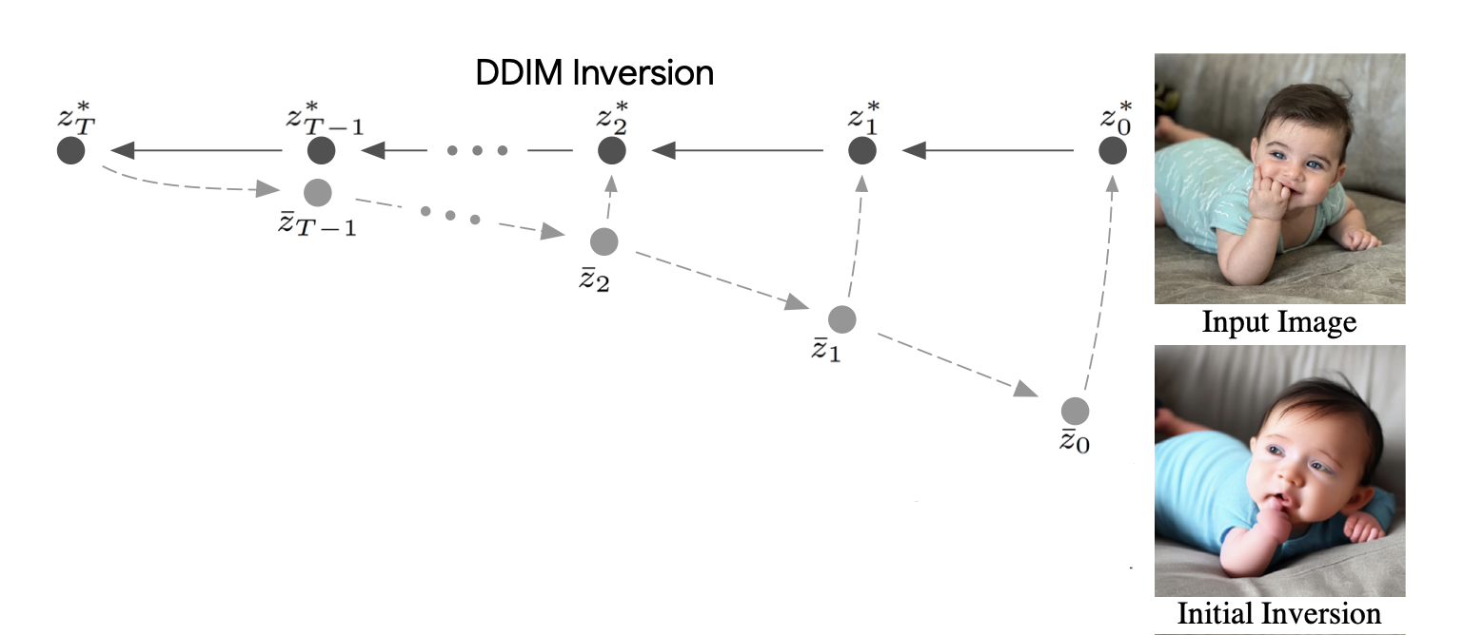
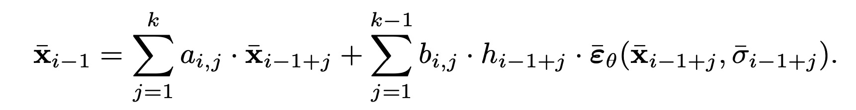
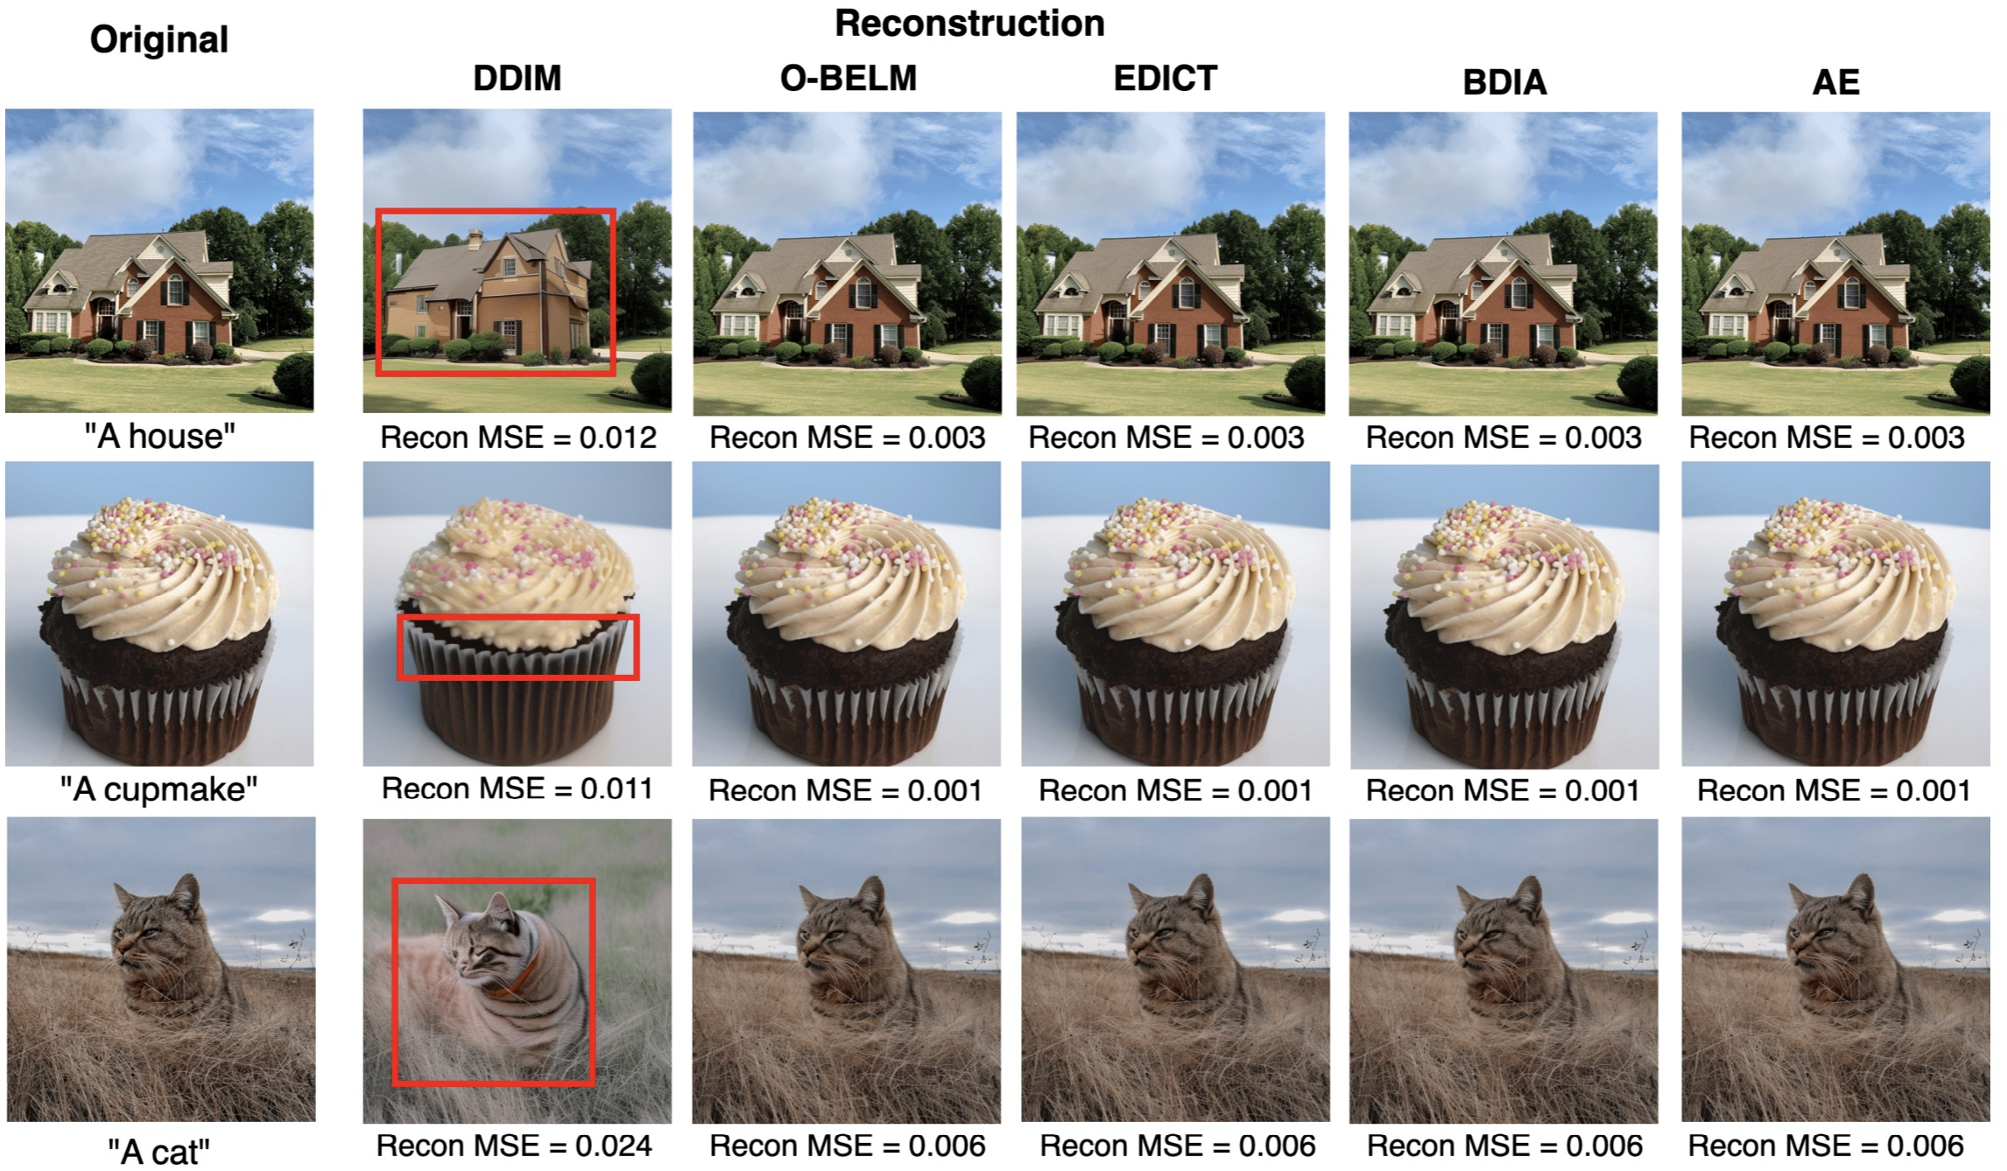
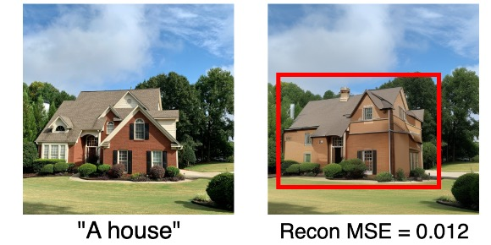
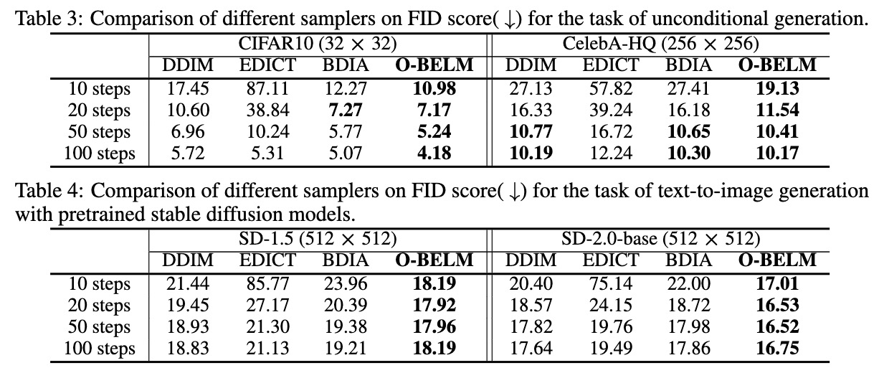
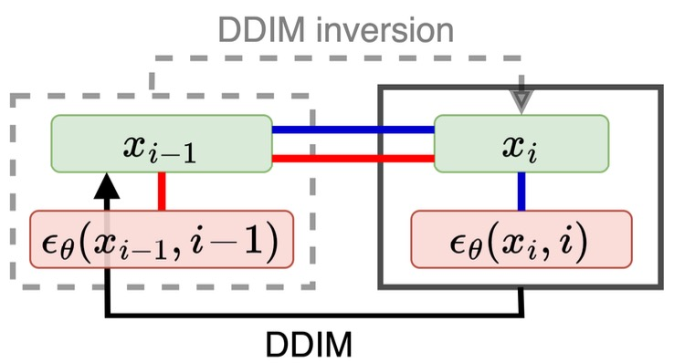
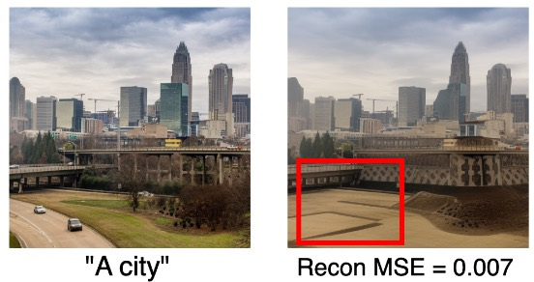
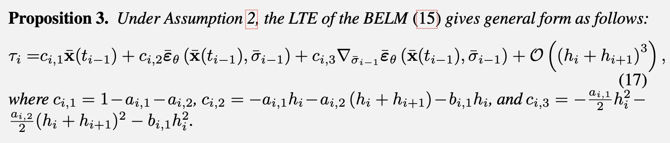
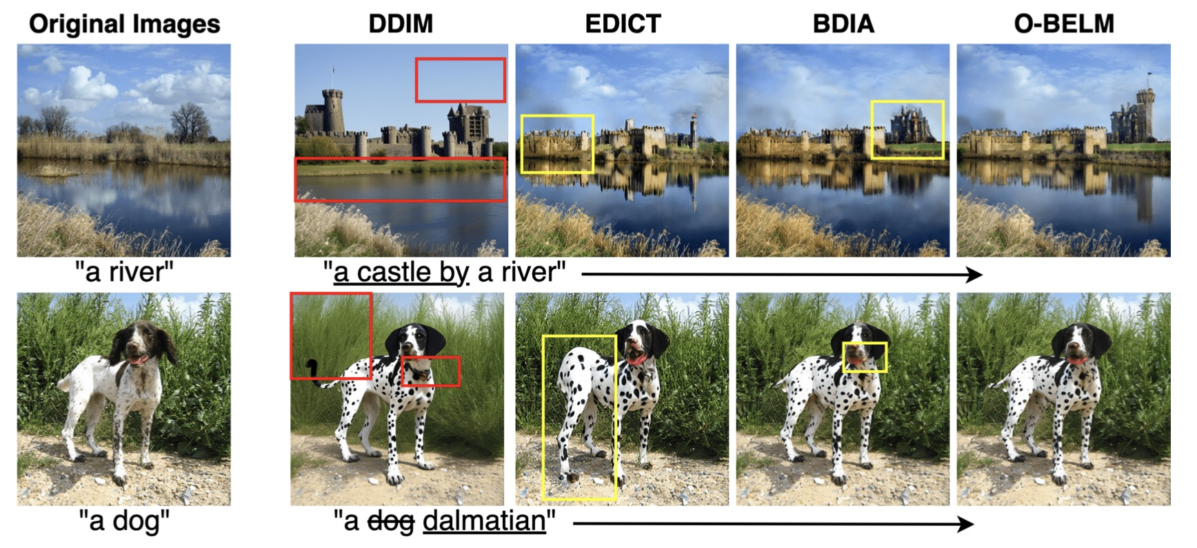
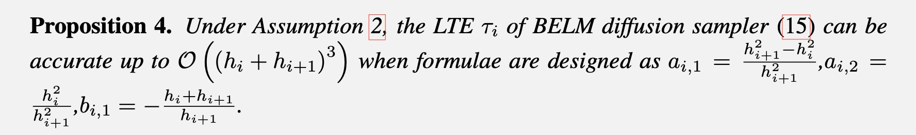
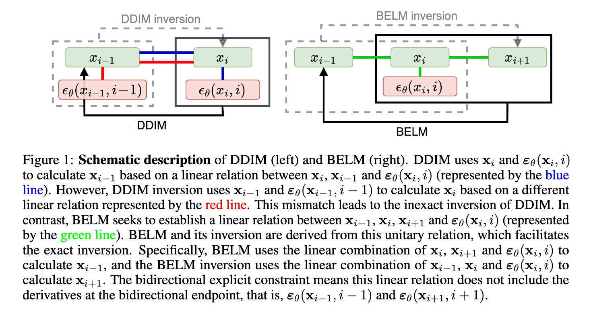
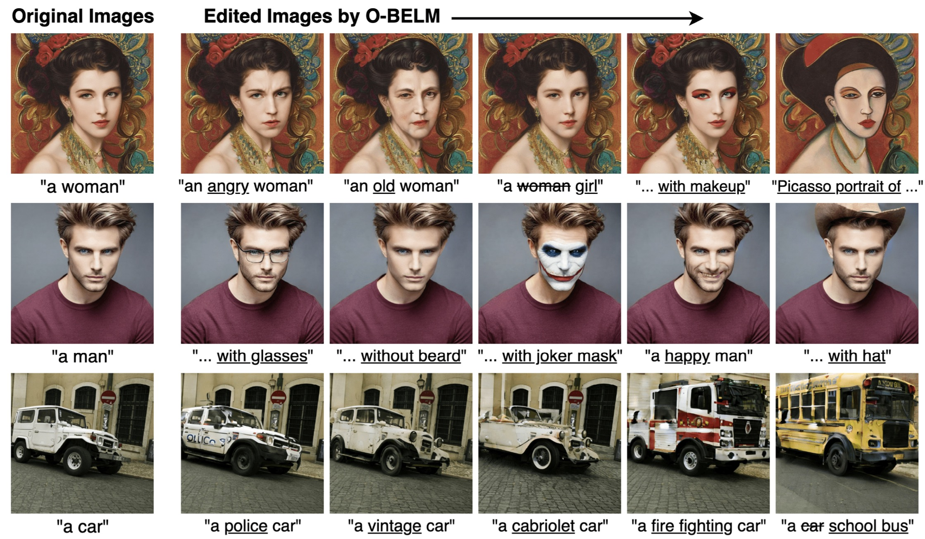
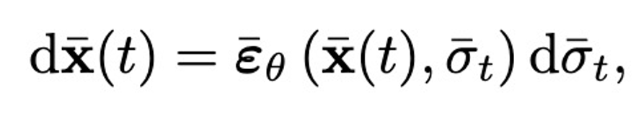
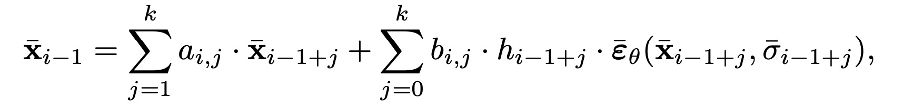
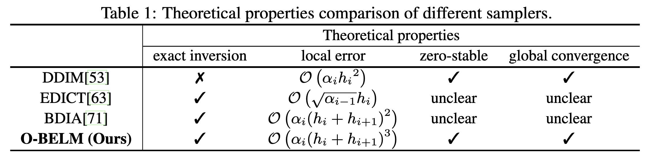
BELM: Bidirectional Explicit Linear Multi-step Sampler for Exact Inversion in Diffusion Models
Fangyikang Wang^{1*}, Hubery Yin^{2*}, Yuejiang Dong³, Huminhao Zhu¹, Chao Zhang^{1†}, Hanbin Zhao¹, Hui Qian¹, Chen Li²
code available
¹ Zhejiang University, ² WeChat, Tencent Inc., ³ Tsinghua University
1. The inconsistency problem of DDIM inversion
Thus, the general k-step BELM writes:
5. Experiments
(k-step BELM sampler)
(3)
BELM samplers (include O-BELM, EDICT, BDIA) both achieve exact inversion
For instance, if we set k=2, the 2-BELM writes:
(2-step BELM sampler)
(4)
The inversion of diffusion model sampling, which aims to find the corresponding initial noise of a sample, plays a critical role in various tasks. DDIM inversion suffers from inconsistency as shown in Figure 1 and 2. The reconstructed images differ from original images obviously. We point out that this is due to DDIM and DDIM inversion uses different linear relation (The red and blue in Figure 3). If we force to use one of the relation for both forward and inversion, then it will result in an implicit formulation in one of the directions.
We show that all BELM can achieve the exact inversion
Figure 1. The inconsistency of DDIM inversion, as illustrated in [1].
We also discover that several heuristic exact inversion sampler (EDICT[2] and BDIA[3]) are indeed special cases of our BELM framework.
O-BELM sampler have better generation quality
3. Optimal Coefficients of BELM via LTE minimization
The heuristic chose of coefficients in BELM will lead to mediocre generative quality. We propose to find the optimal coefficients via minimizing the Local Truncation Error (LTE).
We first derive out the formulation of the LTE of the general BELM:
Downstream tasks: Image editing
Figure 3. The scheme of DDIM and its inversion. DDIM updates following the blue relation. But DDIM updates following the different red relation.
Figure 2. The reconstructed images of DDIM inversion. Inconsistency is outlined by red rectangles.
By minimizing the LTE, we can derive the optimal coefficients within BELM framework
2. BELM framework: a relation explicit in both directions
Core insight: find an unitary relation for both forward and inversion process, as shown by the green line in Figure 4.
We call the BELM sampler with optimal coefficients as O-BELM. The formulation of O-BELM writes:
(O-BELM)
(5)
Figure 5. Comparison of different samplers in image editing. DDIM would cause inconsistency (red part). EDICT and BDIA will cause low-quality region (yellow part). Our O-BELM offers both consistency and good generative quality.
To find such a relation, we first model the inference process of diffusion models into an Initial Value Problem (IVP):
The formulation of O-BELM inversion writes:
Figure 4. The scheme of BELM and its inversion. They are derived on an unitary relation (represented by the green line).
(O-BELM Inversion)
(6)
(Diffusion sampling IVP)
(1)
4. Theoretical Analysis
For general numerical solution to the diffusion IVP, we consider the Variable-Stepsize-Variable-Formula linear multistep (VSVFM) method:
We prove that the proposed O-BELM is zero-stable as well as globally convergent.
(General VSVFM)
(2)
To make sure the VSVFM in eq(2) is explicit in both directions, a necessary (but not sufficient) condition is that $b_{i,0}=b_{i,k}=0$for all $i$.
Figure 6. Examples of editing results using O-BELM on both synthesized and real images.
References :
[1] Mokady, Ron, et al. (2023). Null-text inversion for editing real images using guided diffusion models. CVPR 2023
[2] Wallace, B., Gokul, A., & Naik, N. (2023). Edict: Exact diffusion inversion via coupled transformations. CVPR 2023
[3] Zhang G, Lewis J P, Kleijn W B. Exact diffusion inversion via bidirectional integration approximation. ECCV 2024

